Slide 1
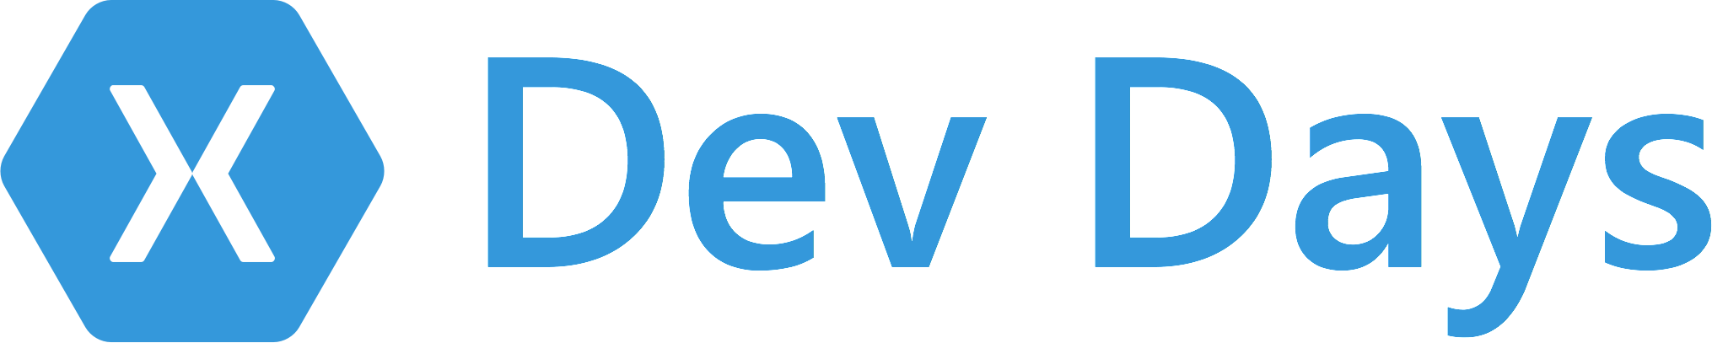

#XamarinDevDays
Notes:
Welcome everyone.
Xamarin Dev Days are super awesome and packed with amazing content that we are gonna help you get through via slide docs & some demos.
How many people are brand new to Xamarin?
How many people are doing thing for a while?

Slide 2

Agenda
Me – Introduction to Xamarin
Prabakaran – Cross Platform UI with Xamarin.Forms
Nish Anil – Connected Apps with Azure
Lunch – Courtesy of Xamarin
File -> New App Workshop
Notes:
Building connected apps with Azure – Mobile apps which is really a cool way of adding backend to the frontend.
Finally, We help you do File -> New App Workshop where we will be building around the first application from scratch.

Slide 3
Slides, Demos, & Lab - Clone or Download:
http://github.com/xamarin/dev-days-labs

Slide 4
Sponsor
Syncfusion.com
#XamarinDevDays
Notes:
Develop custom components using Xamarin.
50+ control in Xamarin
Our components target Xamarin.Android, Xamarin.iOS & Xamarin.Forms

Slide 5


Free Syncfusion License
Essential Studio for Xamarin
Cross-platform mobile development for Xamarin.Forms, Xamarin.iOS, and Xamarin.Android.
Claim your free license at:
www.Syncfusion.com/XamarinDevDays
Deliver innovation with ease

Slide 6
Sponsor
Microsoft.com
#XamarinDevDays

Slide 7

Supporter
meetup.com/bostonmobiledev
#XamarinDevDays
Notes:
Plugin for user groups who were working locally.
Developers can reconnect afterwards, put that right upfront so that everyone knows

Slide 8
Native iOS & Android Development with Xamarin
Harikrishnan
Syncfusion Inc.

Slide 9





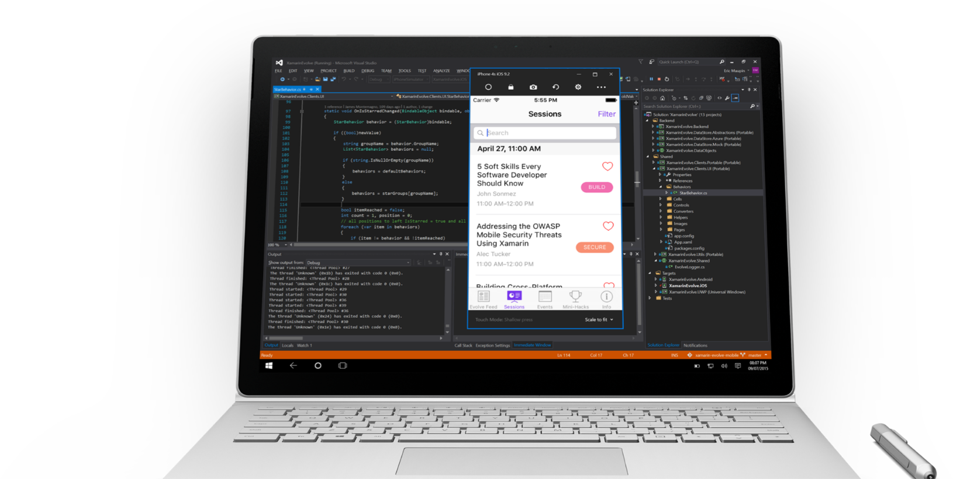
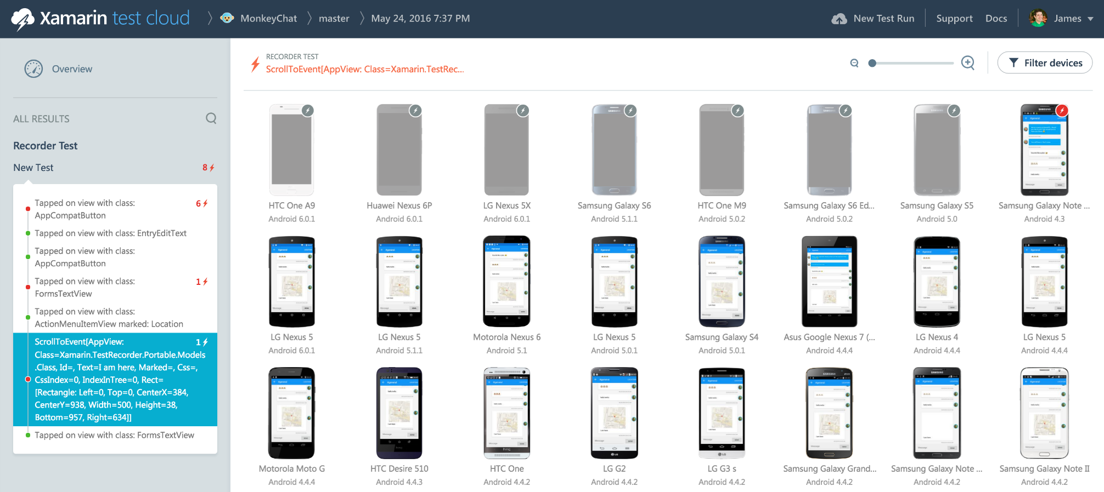
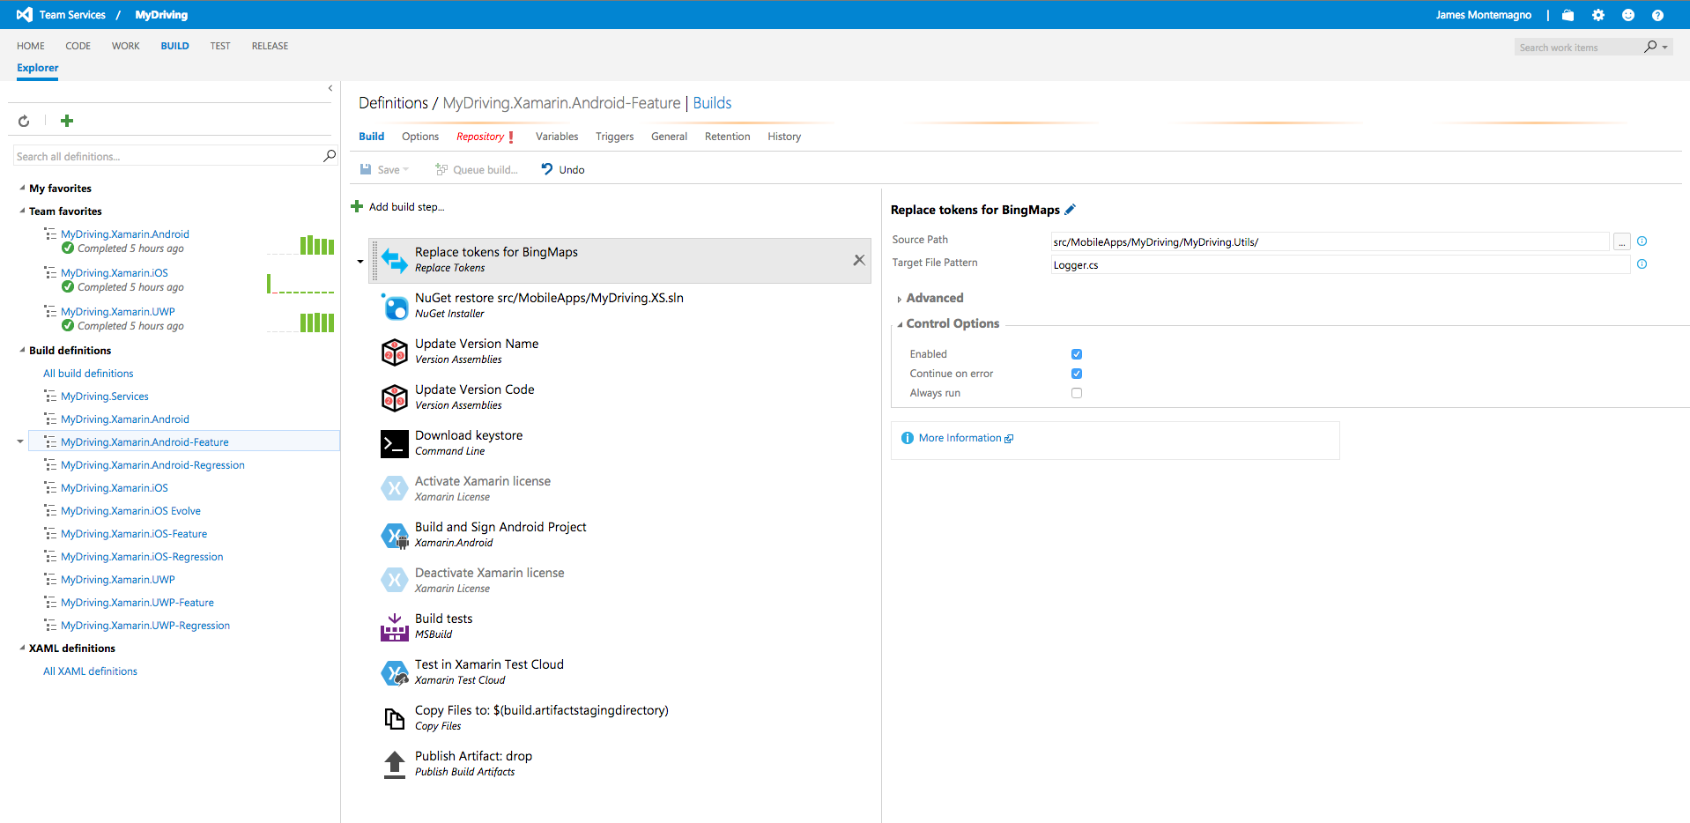
Xamarin – Your Complete Mobile Solution
Develop
Test
Build
Distribute
Monitor
Notes:
Xamarin Platform is usually what you hear about which is building native iOS, Android, Mac, and Windows Apps all in C#
Finally, we need a way to get our apps, not just to app stores. Hockey App – Free tour – that may distribute your apps for free through testers once they are released into a while.
Xamarin offers a wide range of products for developers to go mobile including Test Cloud, Hockey App, and a way to learn all of mobile with University.

Slide 10
Architecting Mobile Apps
Notes:
So we know what we want.
How do we get there?
Let’s talk about the state of mobile development.

Slide 11
Silo Approach
iOS
Android
Windows
Objective-C
Xcode
Java
Android Studio
C#
Visual Studio
No shared code • Many languages & development environments • Multiple teams
Notes:
Want beautiful UI & access to all Native APIs.
Different language, IDE, development environment, tools
Multiple Teams, Multiple Code Bases
Expensive & Slow
Positive = Great apps delivered to user’s platform
But not sharing anything, unlike write once & run everywhere when you for cross platform
Negative = Development hampered by multiple code bases & fragmentation

Slide 12
Write Once, Run Anywhere
Lua
Javascript
Actionscript
HTML+CSS
App Generator
Limited native API access • Slow performance • Poor user experience
Notes:
Often people when they think of CrossPlatform which is very different of what Xamarin is which I want to talk about.
Often, there is a bunch of HTML, JS going into a kind of AppGenerator & FLOPS out apps at the EOD.
This is very different approach from Xamarin, because when this happens this is often a web browser kind of cross compiling.
At the EOD, if you use them they are kind of slow, lacks experience, Limited API support.
Unhappy Users, Unhappy Developers, Increase in Abandoned Apps, Limited to what is implemented

Slide 13
Xamarin’s Unique Approach
iOS C# UI
Android C# UI
Windows C# UI
Shared C# Mobile
Shared C# codebase • 100% native API access • High performance
Notes:
Xamarin enables you to build shared C# mobile backend of your business objects of apps, such as Model, ViewModel, Rest Service, SQL databases in .NET code that can run everywhere.
Develop Android, iOS apps using C# at same time. Gives all tools to build & compile everything inside VS.
Craft a beautiful UI for iOS & Android apps inside a VS and access all the native APIs from C#.
You are sharing 50 – 80 % of your codes with 100 % API access.

Slide 14
Windows APIs
Microsoft.Phone
Microsoft.Networking
Windows.Storage
Windows.Foundation
Microsoft.Devices
System.Net
System
System.IO
System.Linq
System.Xml
System.Data
System.Windows
System.Numerics
System.Core
System.ServiceModel
Notes:
If you are a windows developer, you know that .NET runtime & .NET framework is running somewhere on some windows machine & bundled into your apps.
When you wanna get platform specific APIs whether it is Windows10, WP or ASP .NET you can get those APIs of that platform.

Slide 15
iOS – 100% API Coverage
MapKit
UIKit
iBeacon
CoreGraphics
CoreMotion
System.Net
System
System.IO
System.Linq
System.Xml
System.Data
System.Windows
System.Numerics
System.Core
System.ServiceModel
Notes:
Now think of it when it comes to iOS development in Xamarin.
You get all the DotNet goodness at the bottom.
But instead of running on the .NET runtime, Xamarin enables all the DotNet code run on the mono runtime which is bundled into application.
You get bindings of every single API in iOS.

Slide 16
Android – 100% API Coverage
Text-to-speech
ActionBar
Printing Framework
Renderscript
NFC
System.Net
System
System.IO
System.Linq
System.Xml
System.Data
System.Windows
System.Numerics
System.Core
System.ServiceModel
Notes:
Now think of it when it comes to Android development in Xamarin.
You get all the DotNet goodness at the bottom.
But instead of running on the .NET runtime, Xamarin enables all the DotNet code run on the mono runtime which is bundled into application.
You get bindings of every single API in Android.

Slide 17
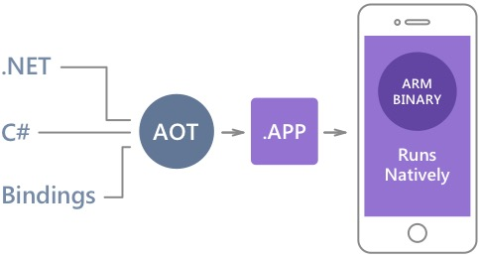
Native Performance
Xamarin.iOS does full Ahead Of Time (AOT) compilation to produce an ARM binary for Apple’s App Store.
Xamarin.Android takes advantage of Just In Time (JIT) compilation on the Android device.
Notes:
Xamarin does not cross compile.
Own compiler, linker & optimizer for both Android & iOS to go through their own passes to surely build a native assembly at the EOD.
On Android, things are different. No ahead of time because android turn around apps in lot of VM or Dalvik runtime.
Xamarin actually runs the mono-runtime side by side. They do have a super fast JIT compilation process.

Slide 18
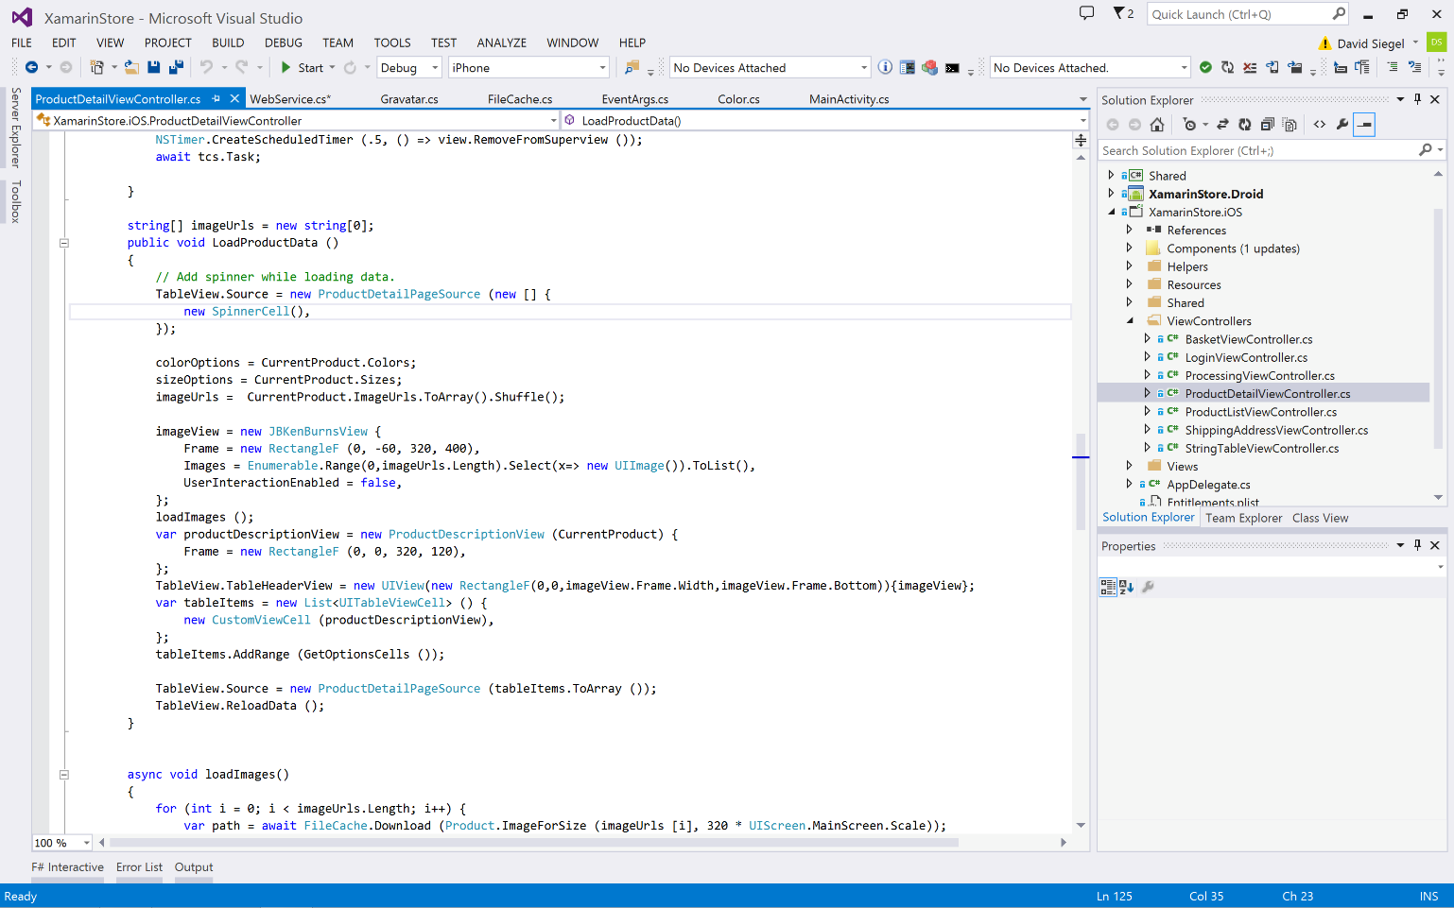
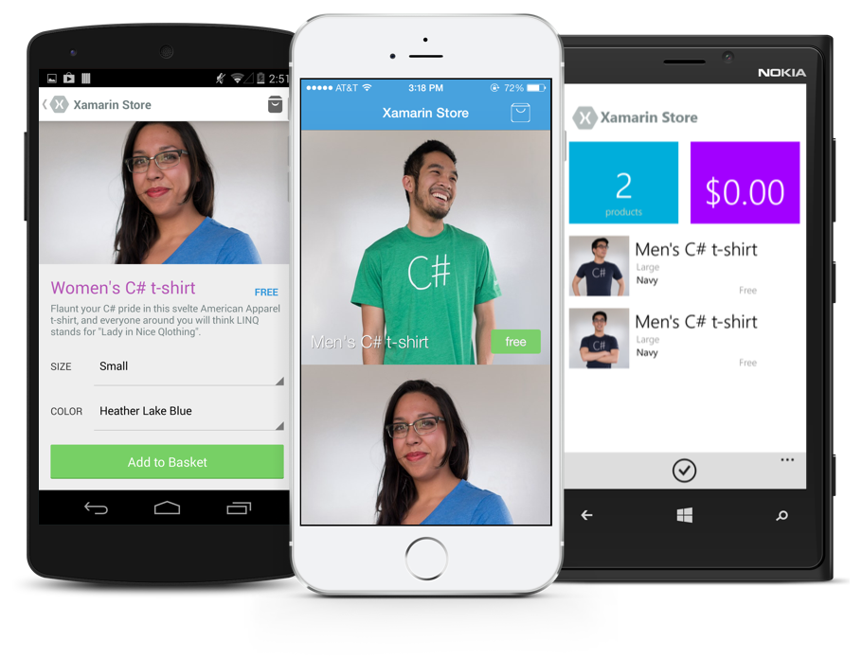
Anything you can do in Objective-C, Swift, or Java can be done in C# and Visual Studio with Xamarin.
Notes:
Coming up next is bubbles

Slide 19
✓Always Up-to-Date
Same-day support:
iOS 5
iOS 6
iOS 7
iOS 7.1
iOS 8
iOS 9
Full support for:
Apple Watch
Android Wear
Amazon Fire TV
Google Glass
and much more

Slide 20
Development Experience
Notes:
Before we go and actually code & look at the sample, how to actually build this stuff?
Where we gonna be working on every single day?

Slide 21
Xamarin is included in Visual Studio
Xamarin is included
in Visual Studio
Including Community Edition!
Notes:
No additional cost.

Slide 22
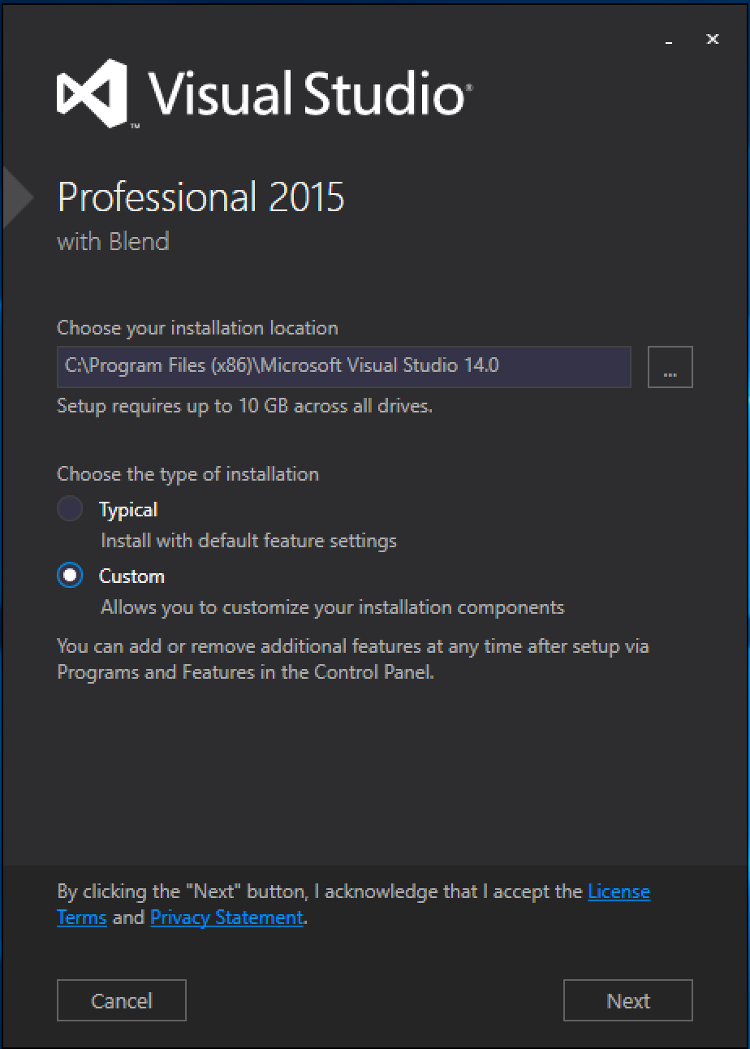
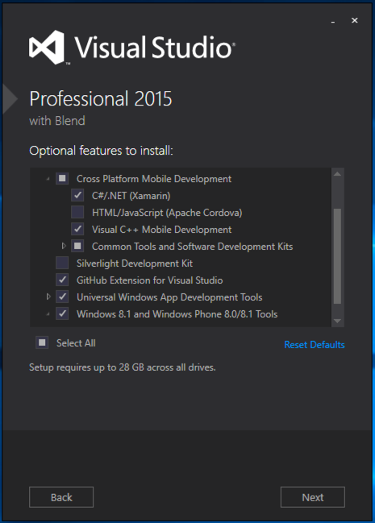
Visual Studio Integration
Xamarin.com/Download
Notes:
Good to go with everything you need inside VS.
If mac, URL – download all the tools you need.

Slide 23
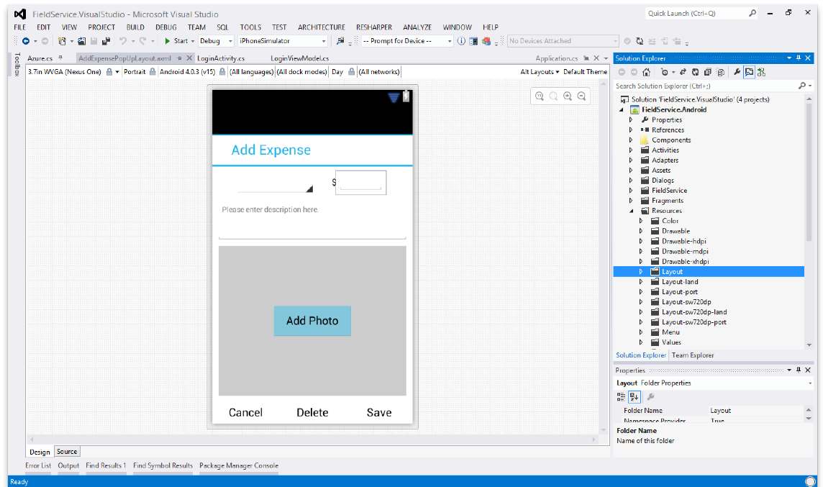
Android Designer
Create UI with drag & drop simplicity
Target multiple screen sizes, resolutions and Android versions
Layouts saved in standard Android XML files

Slide 24
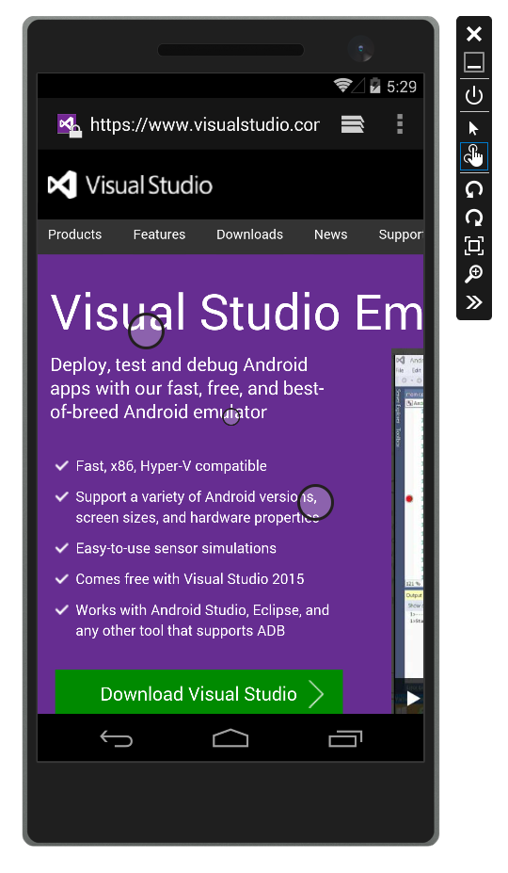
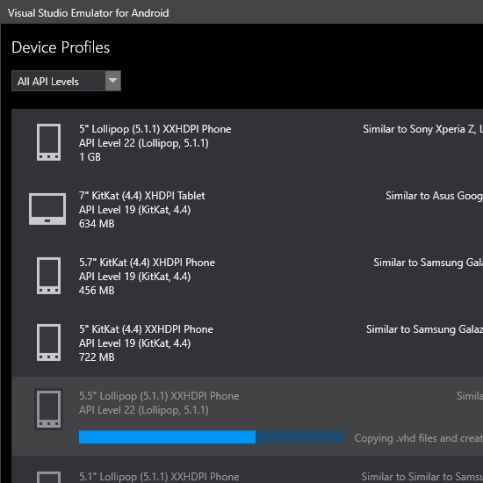
Android Hyper-V Emulators for PC
Multi-Touch Enabled
Super Fast
Rotate, screenshots, location changes, and more!
http://bit.ly/hyperv-android

Slide 25
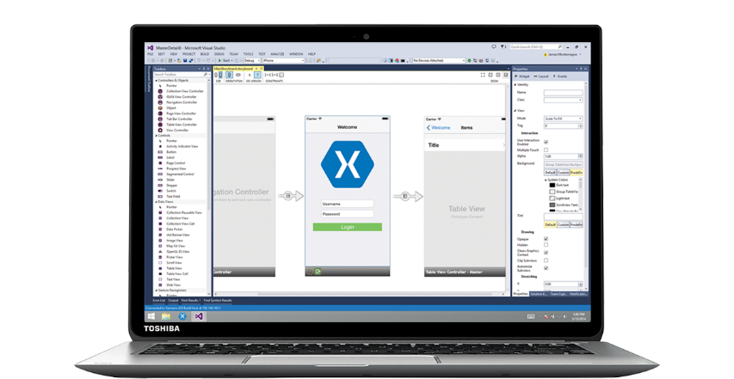
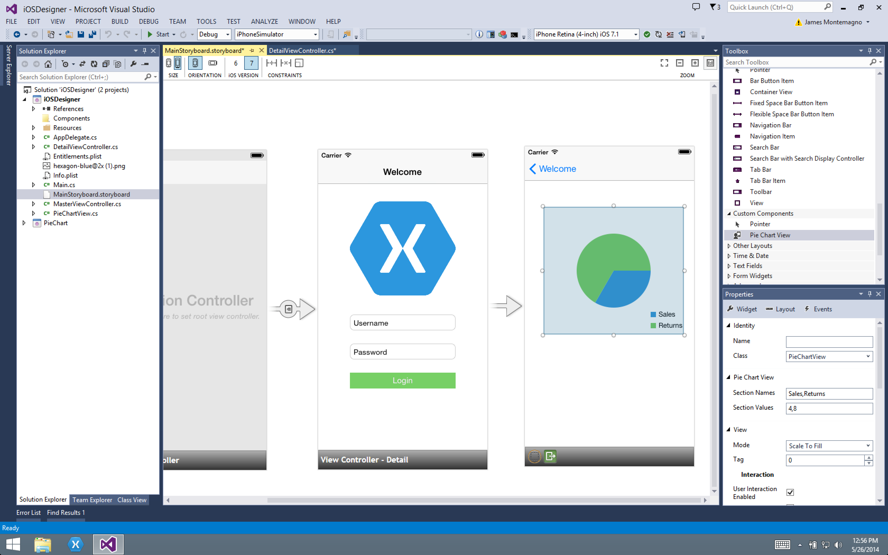
Xamarin Designer for iOS
Follows familiar Visual Studio designer idioms
Supports all UIKit elements
Edit custom and 3rd party components
Live preview of changes to properties
Notes:
This video will show you all the little cool things that you can do.
I embedded this video, just in case if anything terribly goes wrong for iOS.
So now, we can have the idea of development experience here.
Really optimized for .NET developers. Double clicking on a control brings you out to a click handler.
PropertyWindow.

Slide 26

Visual Studio iOS Simulator Remoting
Multi-Touch Enabled
Pressure Sensitive
Super Fast
Rotate, screenshots, location changes
Never leave VS
*available as a preview

Slide 27
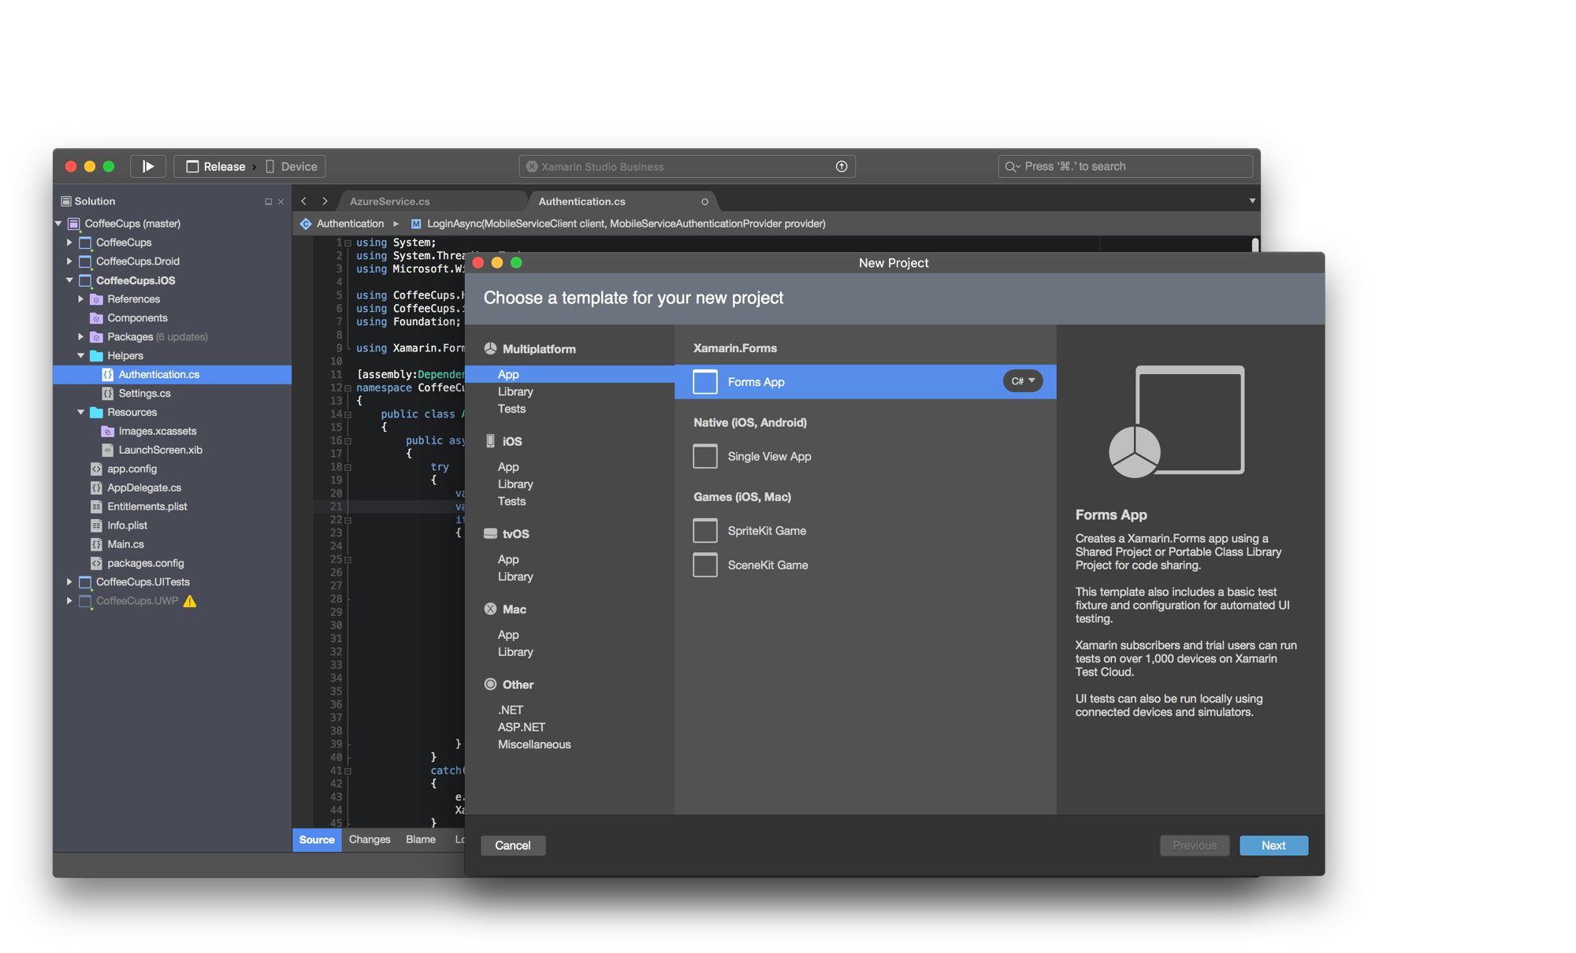
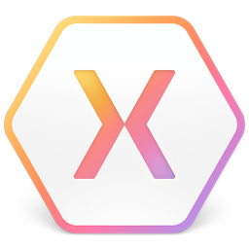
Xamarin Studio – Mac
Notes:
Xamarin Studio on Mac offers: Android, iOS and Mac development
World Class IDE with great features:
Code Analysis
Upload to Test Flight
Git & Subversion Integration
Code Completion
Code Navigation
Easy transition from Visual Studio
The same Solution & Projects open in BOTH Xamarin Studio and Visual Studio!

Slide 28
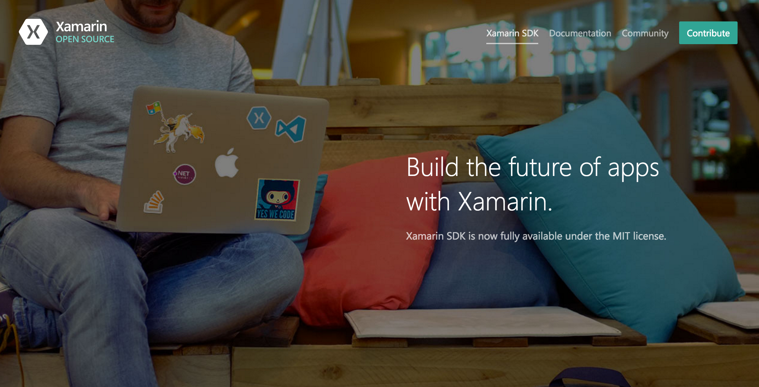
Open Source – open.xamarin.com
Notes:
Xamarin SDKs are completely open source.
Xamarin.iOS, Android, Xforms, components & widgets all these things are open sourced.
Take a look at how they are build up and start contributing to Xamarin.

Slide 29
Sharing Code
Notes:
How development is on day to day basis?
How actually we can share some code, while building applications?

Slide 30
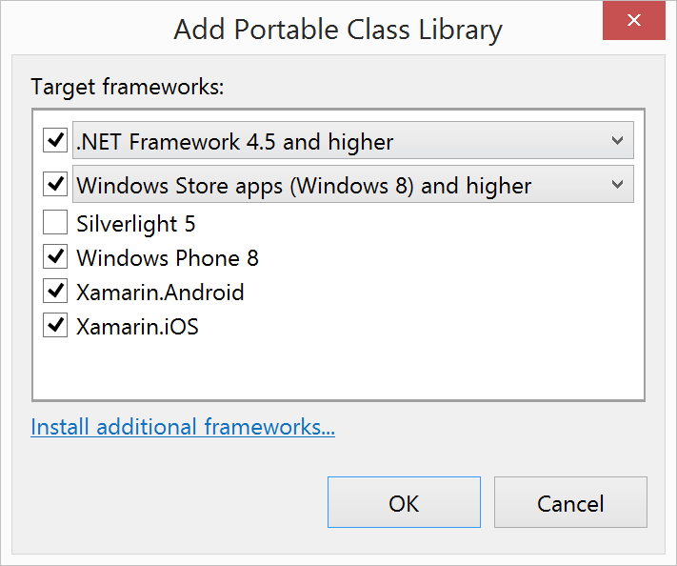
Portable Class Libraries
1 Assembly
Multiple Platforms
Including:
Xamarin.iOS and Xamarin.Android
Notes:
PCL targets different platforms that you wanna support.

Slide 31
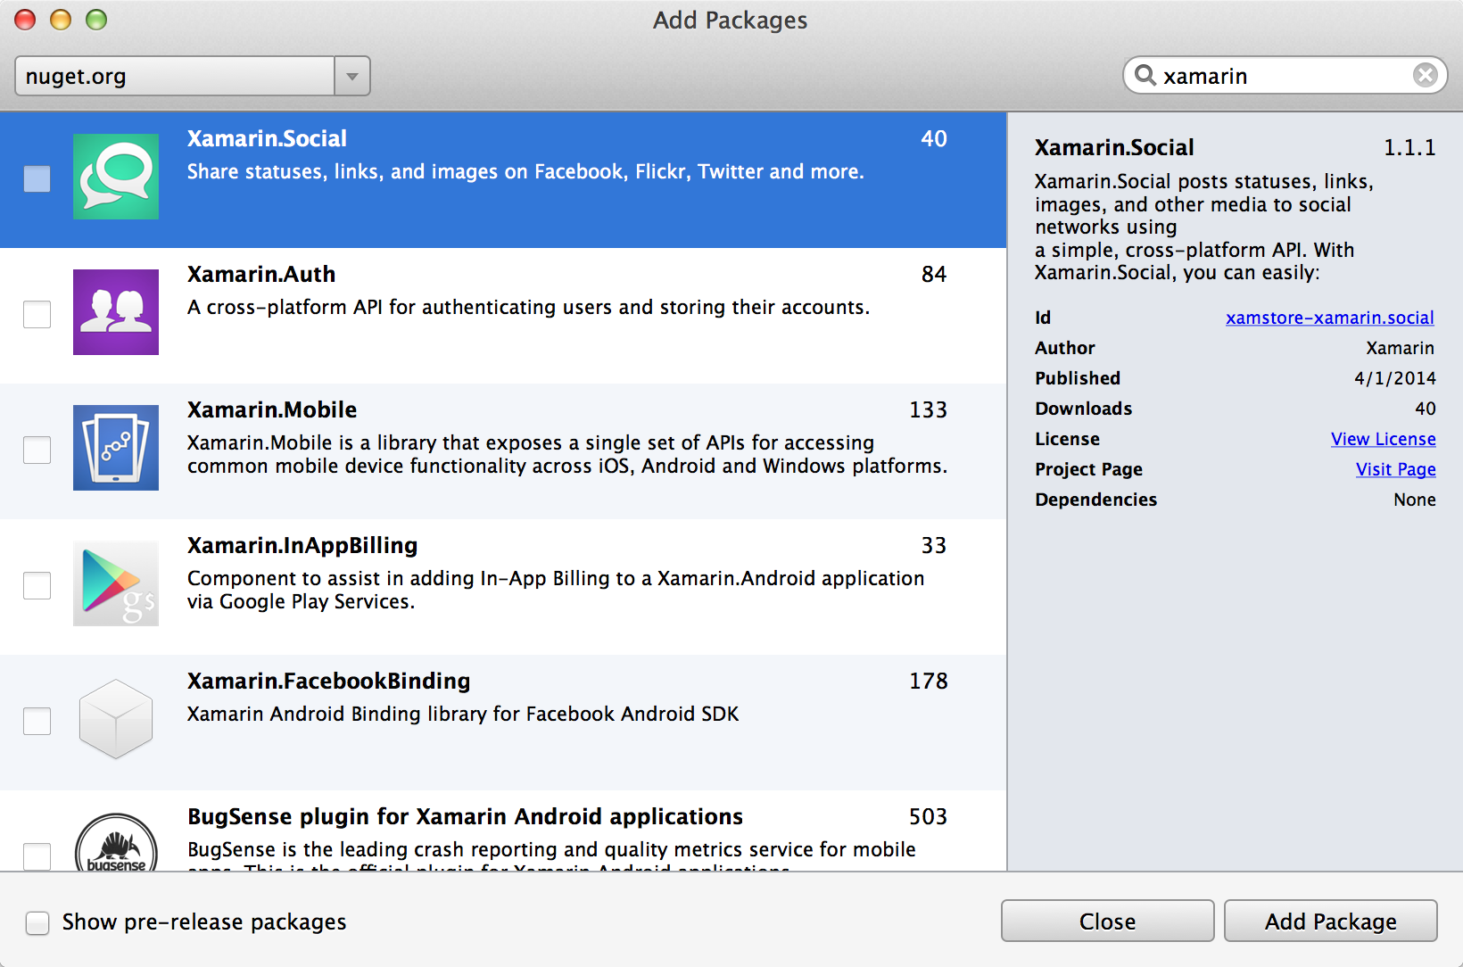
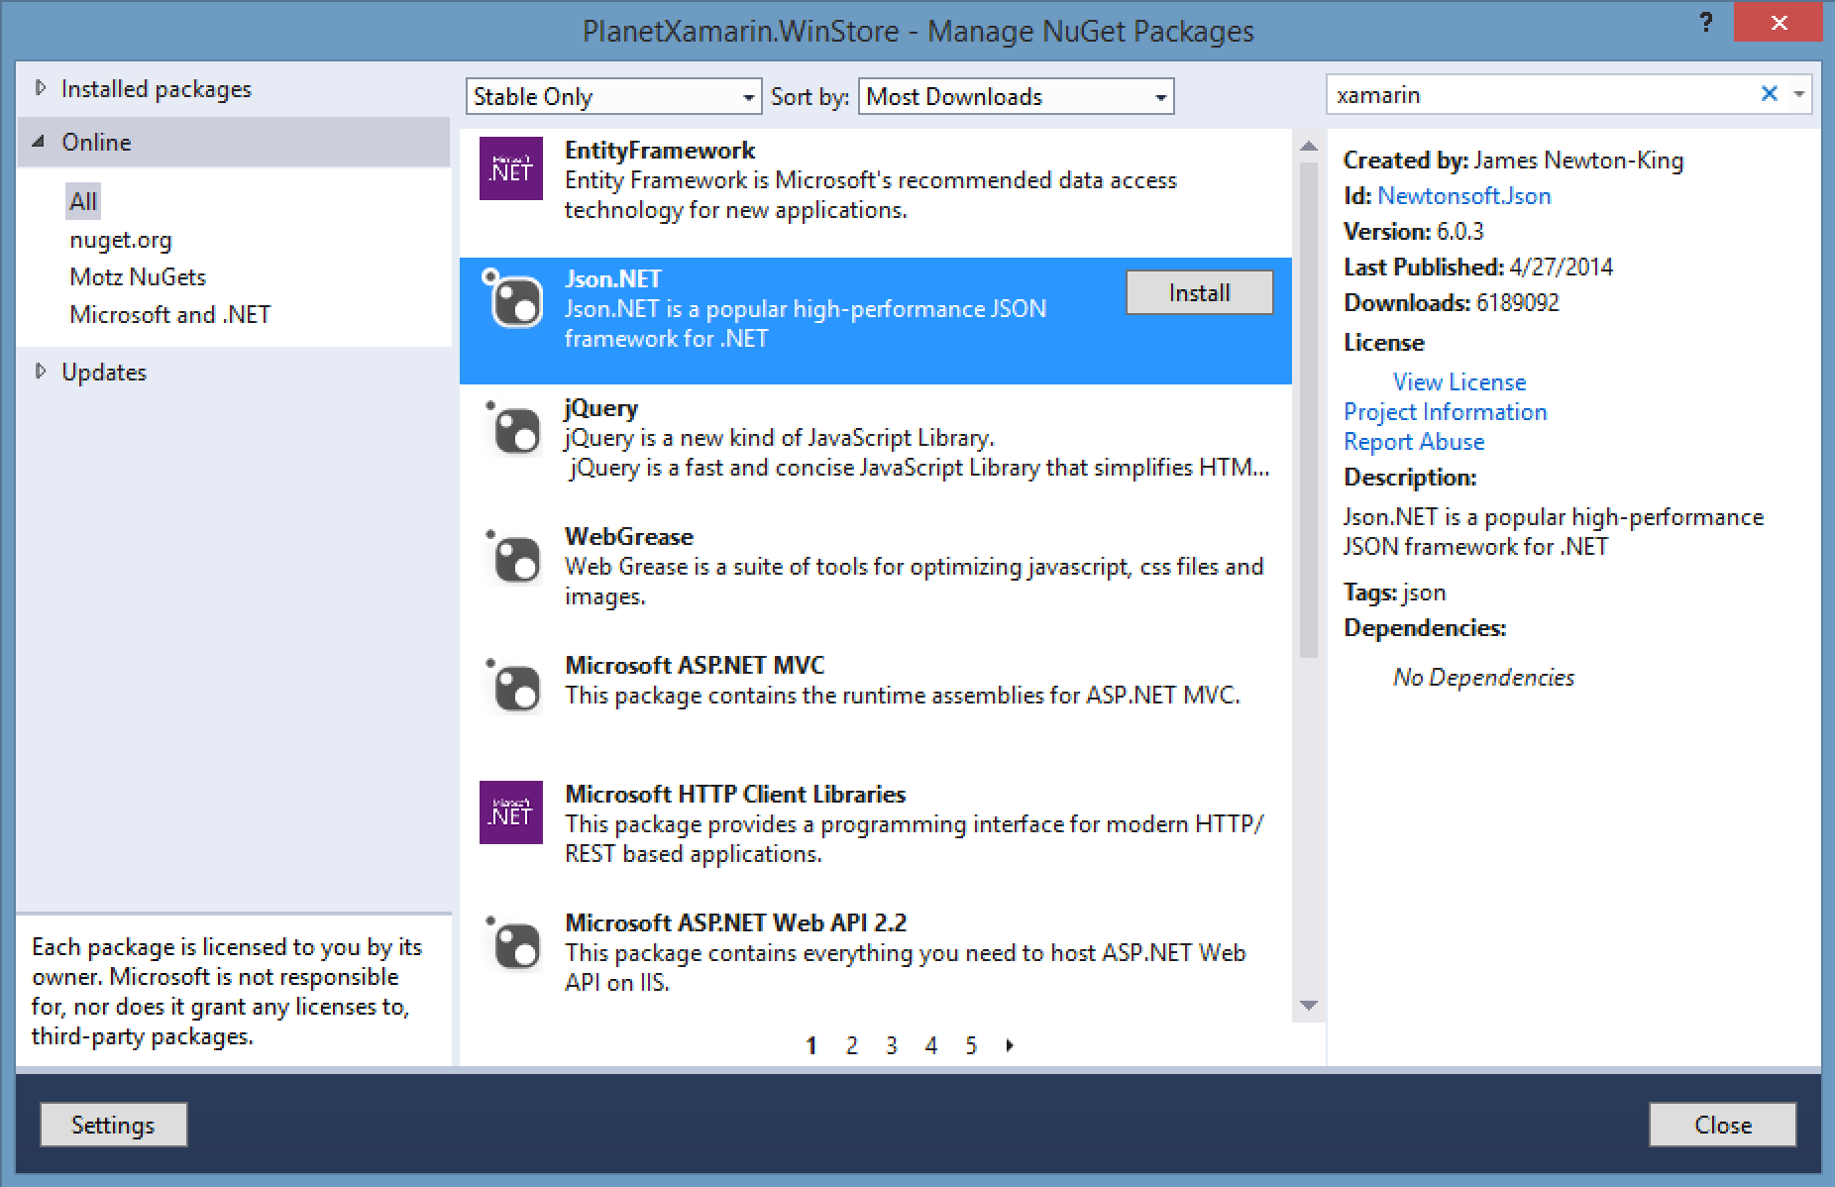
NuGet
Notes:
Things are really great with NuGets.
You can create Libraries, PCL – you come back in and distribute them.

Slide 32
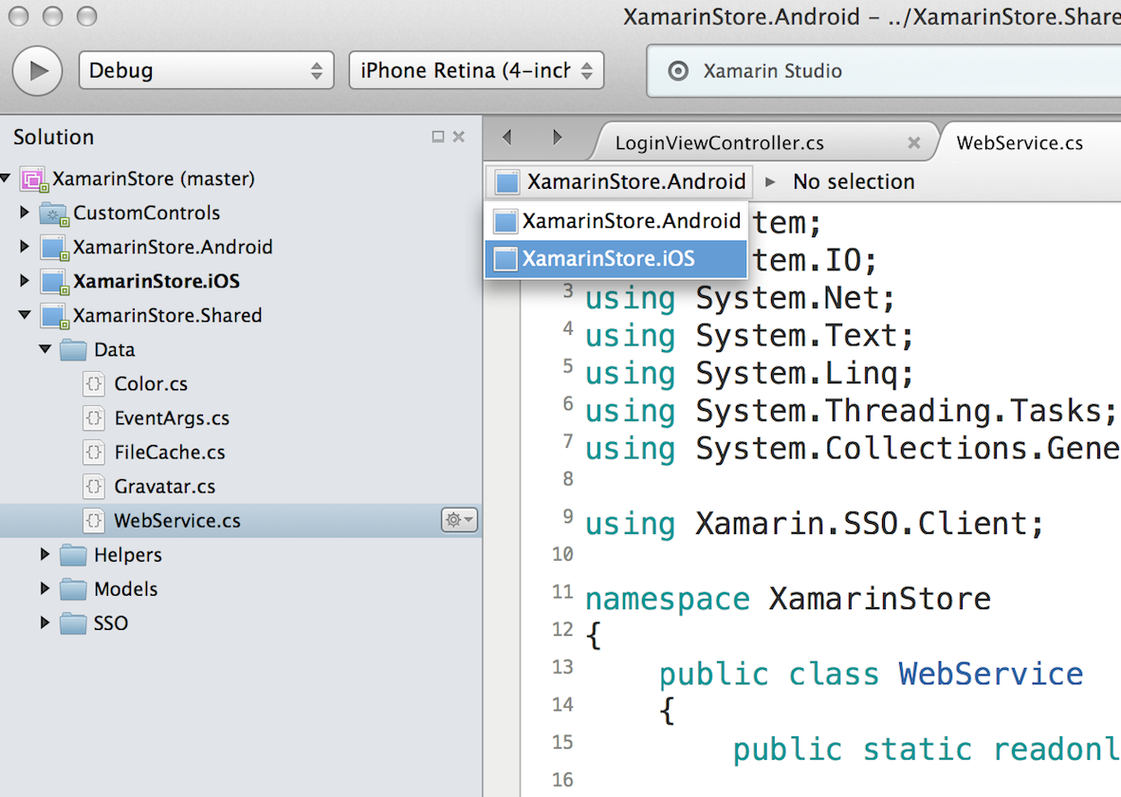
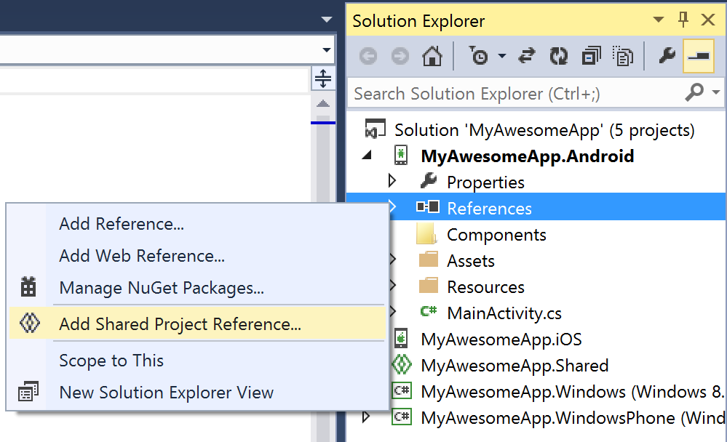
Shared Projects
Notes:
Breaks down the barriers of the subset of .NET all together.
Things in iOS, Android & WP that I can write against. I just wanna write some code files & I wanna share & link them in – Shared project just do that.
No Assembly, References. Its just code files that automatically get added in each other sub projects.

Slide 33
Code Sharing Stats
Calca
iCircuit
Touch Draw
Android
iOS
Mac
Windows Phone
Notes:
Average developer shares 70% of code across each platform when building with traditional approach.

Slide 34
Let’s Build an App

Slide 35
Simplifying Development
Notes:
What happens when you wanna take it a step further?
What happens when we add these unique APIs access the native APIs on each platform?

Slide 36
Shared C# Backend
Notes:
We have the shared C# backend but whats all these stuff?
We have only written a few lines of code which is pretty impressive. Now what happens when you integrate these stuff in?

Slide 37
Platform Specific Code
UI+APIs
UI + APIs
UI + APIs
Battery
GPS
Lights
Notifications
Settings
Text To Speech
Battery
GPS
Lights
Notifications
Settings
Text To Speech
Battery
GPS
Lights
Notifications
Settings
Text To Speech
What if we didn’t have to write this code?
What if we could access it from shared code?
Notes:
You saw earlier that we had the ability to pop up a notification right from my shared code.
What if the developers didn’t have to write codes 3 different times in 3 different platforms.
What if we could access this from shared code?

Slide 38
Speak(“Hello World”);
AVSpeechSynthesizer
TextToSpeech
SpeechSynthesizer
Notes:
We have a speech API that exists on all three platforms.
So you just wanted an API called speak and UNDERNEATH it should call each platform.

Slide 39
Plugins for Xamarin
github.com/xamarin/plugins
Common API
Notes:
This is where plugins for Xamarin come up with.
You will be taking a look at some more during the next session accessing a single API for common APIs in all the three platforms.

Slide 40
10 Minute Break
Harikrishnan
Syncfusion Inc.
harikrishnann@syncfusion.com nharishkrish@gmail.com
https://www.syncfusion.com/products/xamarin/datagrid
https://www.linkedin.com/in/hari-krishnan-304a0272

